Slide 1

LART
Laplace Noise and Multiple Additive Regression Trees
CS534 – Group 14
Peter Rindal
Trung Viet Vu
Hung Viet Le

Slide 2


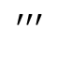
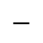
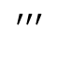
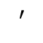
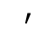
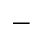
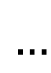
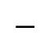
Multiple Additive Regression Trees (MART)
Aba Boosting tree for regression
Good: series of weak predictive models form high accuracy ensemble
Bad: later iterations make negligible contribution
$$′$$
$$′$$
$$…$$
$$′′′$$
$$′′′$$
$$−$$
Error
$$−$$
$$−$$
Learn
Learn
Learn
Predict
Predict
Predict

Slide 3

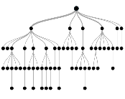
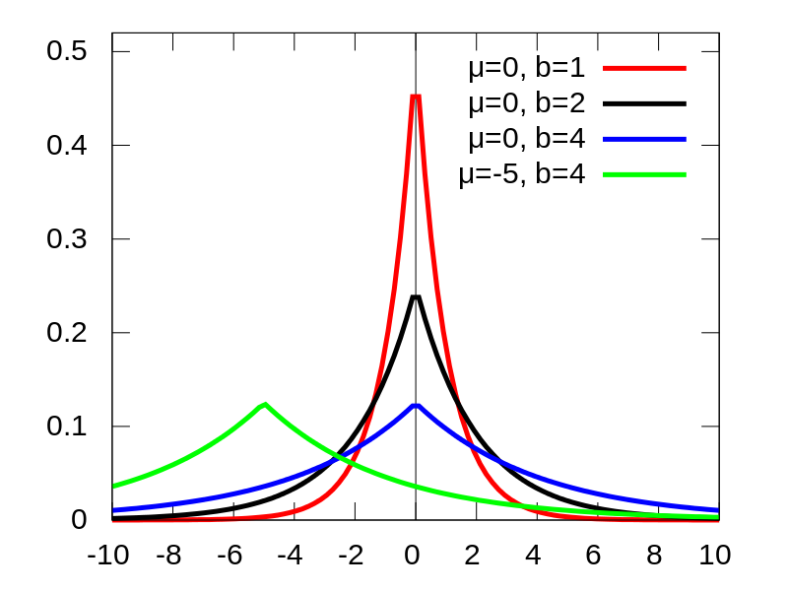
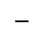
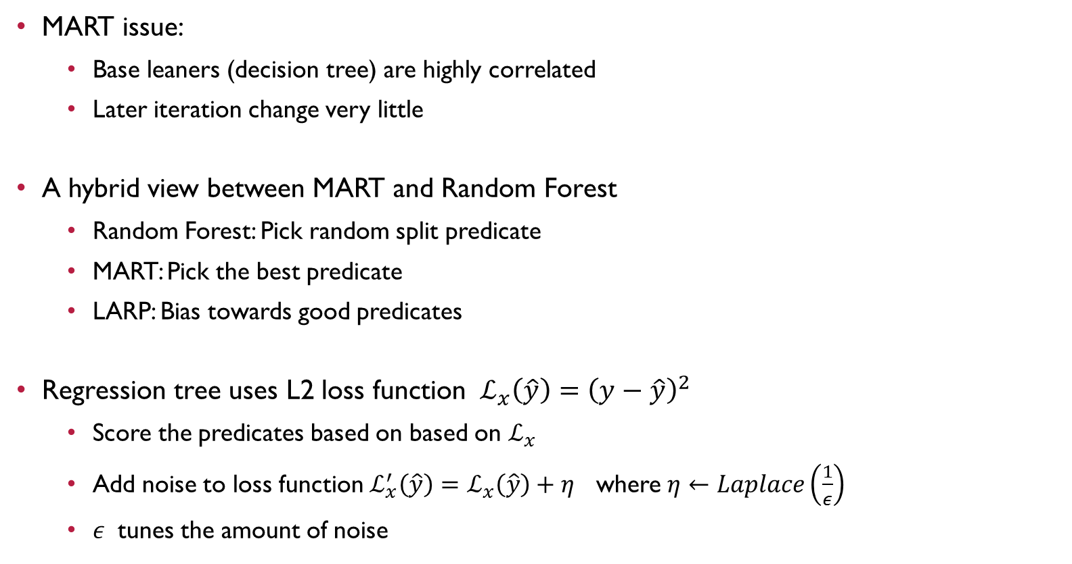
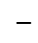
Laplace Noise and Multiple Additive Regression Trees
$$−$$
$$′$$
$$−$$
$$′$$
MART issue:
Base leaners (decision tree) are highly correlated
Later iteration change very little
A hybrid view between MART and Random Forest
Random Forest: Pick random split predicate
MART: Pick the best predicate
LARP: Bias towards good predicates
Regression tree uses L2 loss function $ℒ_{x}\left(\hat{y}\right)={\left(y−\hat{y}\right)}^{2}$
Score the predicates based on based on $ℒ_{x}$
Add noise to loss function $ℒ_{x}^{′}\left(\hat{y}\right)=ℒ_{x}\left(\hat{y}\right)+η$ where $η←Laplace\left(\frac{1}{ε}\right)$
$ε$ tunes the amount of noise
Learn
Learn
Predict
Predict
Laplace Distribution (PDF)

Slide 4
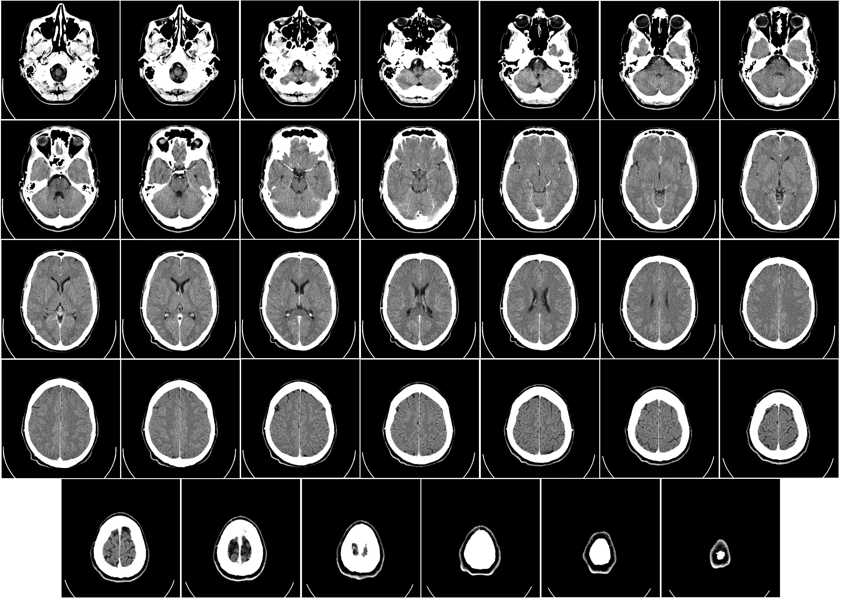
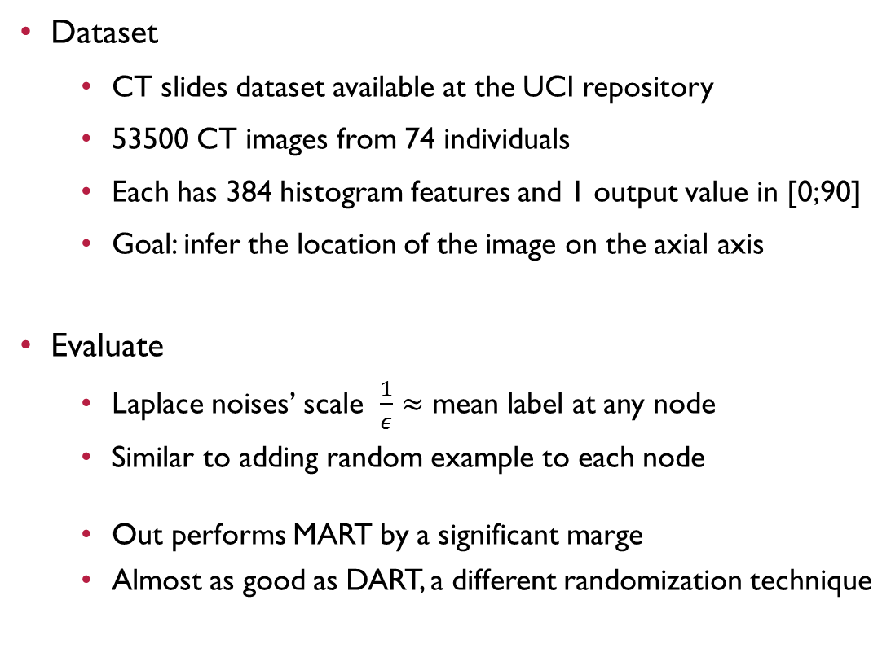
Experiments
Dataset
CT slides dataset available at the UCI repository
53500 CT images from 74 individuals
Each has 384 histogram features and 1 output value in [0;90]
Goal: infer the location of the image on the axial axis
Evaluate
Laplace noises’ scale $\frac{1}{ε}≈$ mean label at any node
Similar to adding random example to each node
Out performs MART by a significant marge
Almost as good as DART, a different randomization technique

Slide 5
Conclusions
LART randomizes the base learners
Result in a more robust/diversified base learner
Laplace distribution ensure good predicates are still preferred
Out performs the MART algorithm by a significant margin
Not quite as good as DART which randomizes on the tree level vs node level
Future work: Combine Dart (randomized trees) and LART (randomizing nodes)
Thank you!

